Slide 1
Information Retrieval
Assignment 7 Probabilistic Models
Presented by: M. Umair Shahid [2021-CS-144]
Instructor: Dr. Khaldoon Syed Khurshid
Department of Computer Science University of Engineering and Technology Lahore

Slide 2
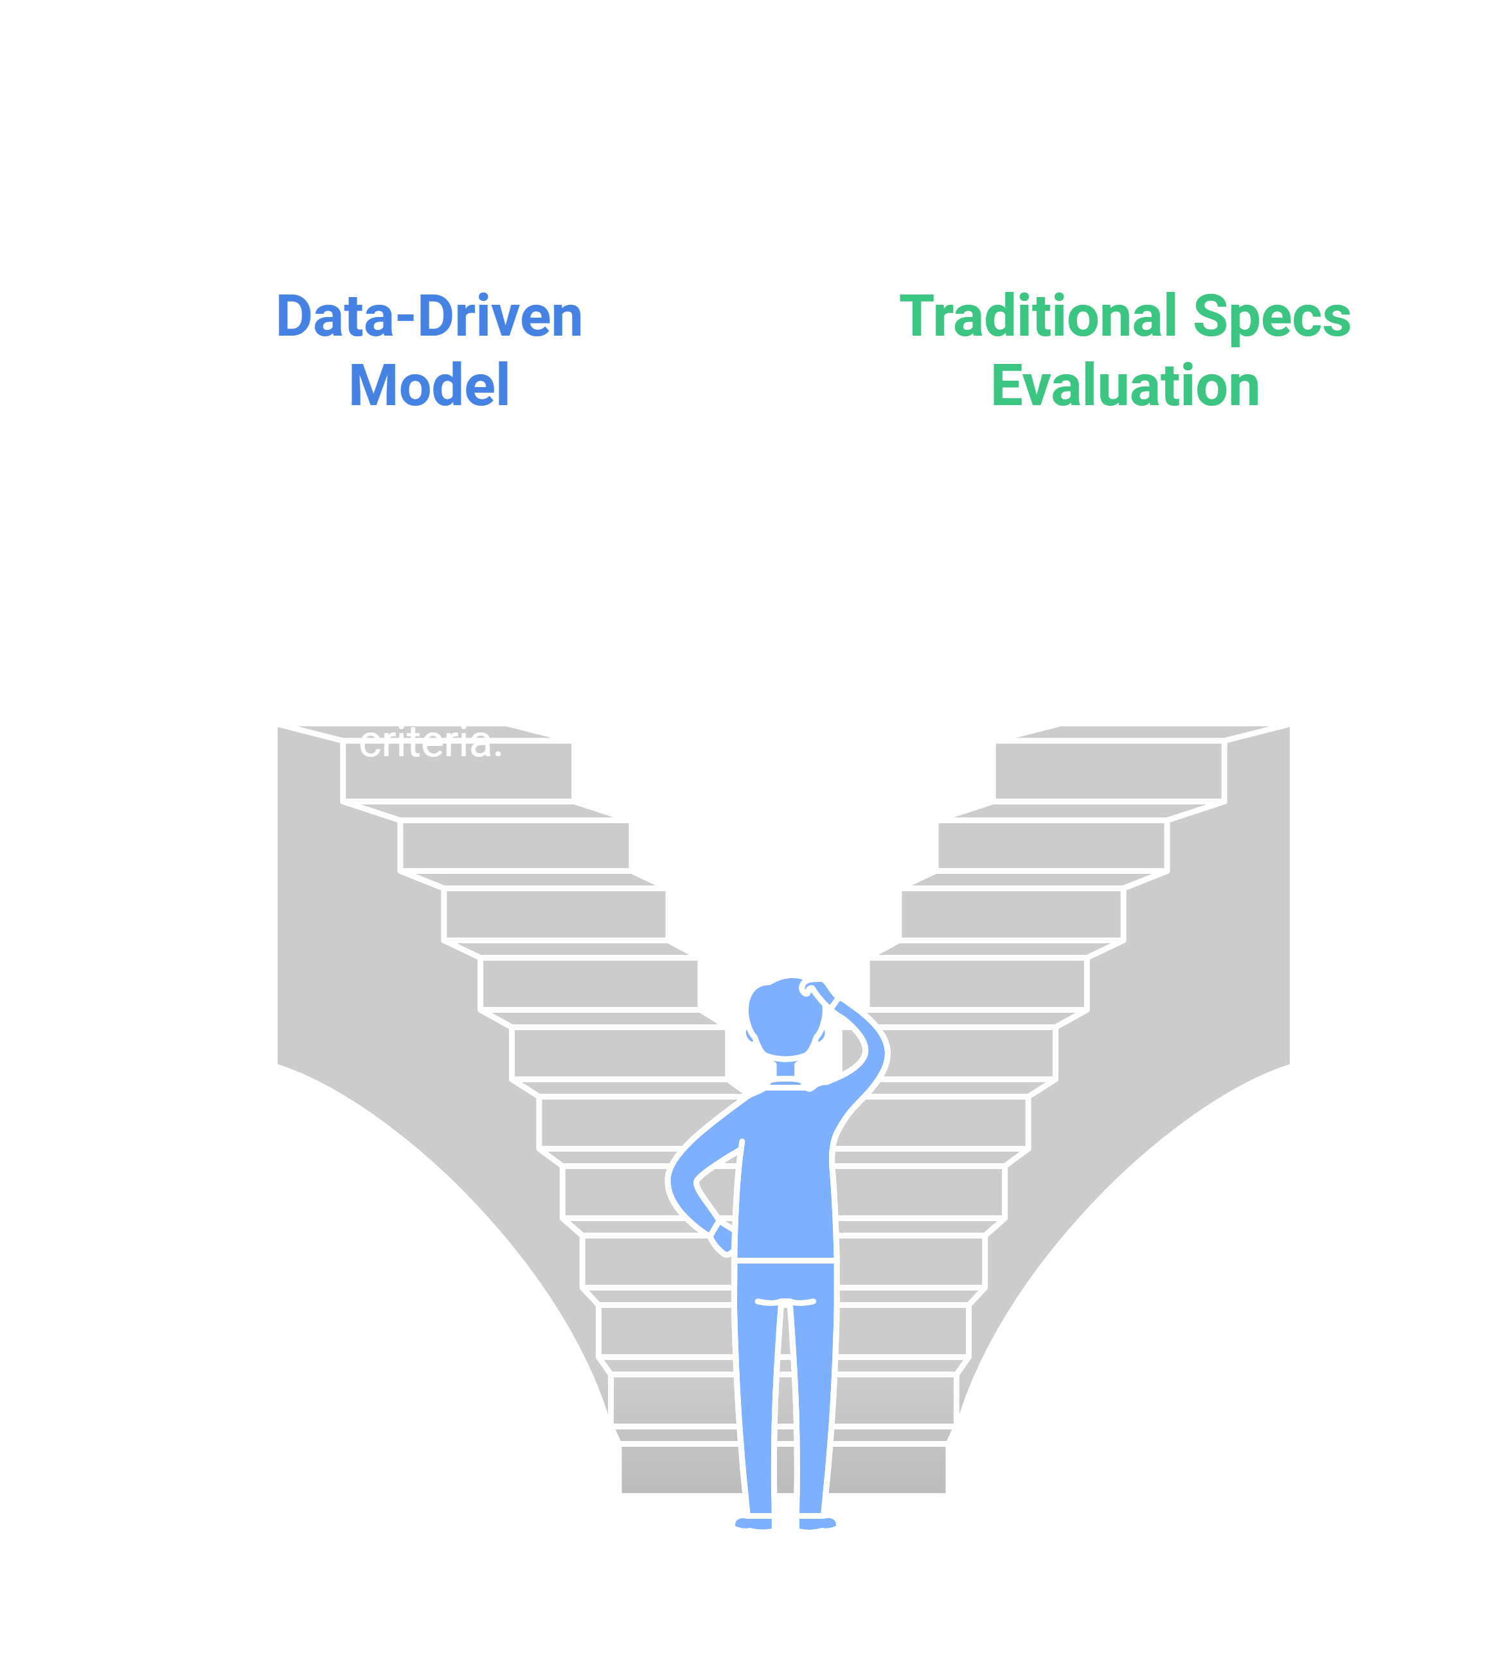
Introduction
Problem: Choosing a smartphone with a great camera is tough—so many options, ratings, and features
Our Approach: Use a data-driven, Bayesian-inspired model to simplify the decision.
Key Idea: Let’s think probabilistically. Instead of just looking at specs, we ask: “How likely is this phone to be ‘relevant’ given our criteria?”
Imagine you have 100 phones. We want a way to guess how many of these phones would meet your chosen standards, and from that, figure out which ones are most “deserving” of your attention.

Slide 3

Goal Definition
Main Goal: Given a user’s minimum requirements (e.g., user rating ≥ 4.0, expert rating ≥ 4.0), rank smartphones by their likelihood of being “relevant.”
Why? So you can quickly find top candidates that match your camera quality preferences.
If you say, “I only want phones that people and experts really love,” we find how many fit that idea and then measure each phone’s chance of fitting into that “loved” category. Think of it like sorting marbles: we pick out those that meet your color criteria, then find which of them are most special.

Slide 4
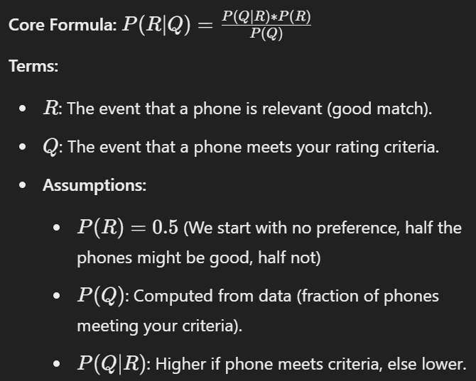
Inference Model
Imagine you have no idea which phones are good, so you start by guessing half are good. After checking how many meet your rating needs, you revise your guess for each phone. If a phone fits your needs, it jumps in credibility. If not, its credibility drops.

Slide 5
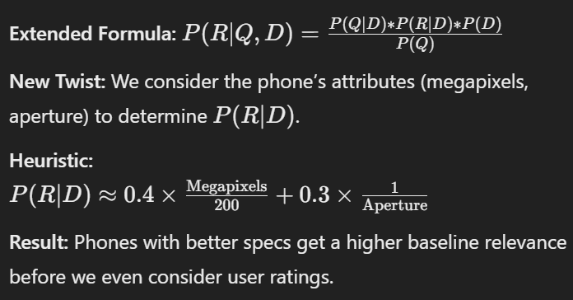
Belief Network Model
We don’t just randomly guess which phones are good. We look at their camera specs. If it has lots of megapixels and a great aperture, it probably starts out more “relevant.” It’s like grading a test: a student who answered more questions correctly gets a better starting score before extra criteria are applied.

Slide 6
Example and Implementation
Examples:
Online stores filtering phones by camera quality.
Tech reviewers quickly identifying top picks for photography enthusiasts.
Research labs studying which attributes influence perceived camera quality.
Implementation:
Python, Tkinter GUI
On-screen results update as you tweak ratings.
Think of a shopping website: You type in “I want 4+ star phones with expert approval.” Behind the scenes, this model quickly figures out which phones deserve to be at the top of your search results. You see a nice, clean list on your screen—no guesswork needed.

Slide 7
Shortcomings
Limitations:
Simple assumptions about probability (e.g., 𝑃(𝑅)=0.5P(R)=0.5)
Basic attribute weighting
No nuanced rating distributions—just thresholds
Future Enhancements:
More sophisticated priors (not always 0.5)
Continuous rating distributions and fuzzy logic
Machine learning models to learn weights from user feedback

